Slide 1

Selection Bias
Alan Fossa, MPH
EPID601
September 2020

Slide 2
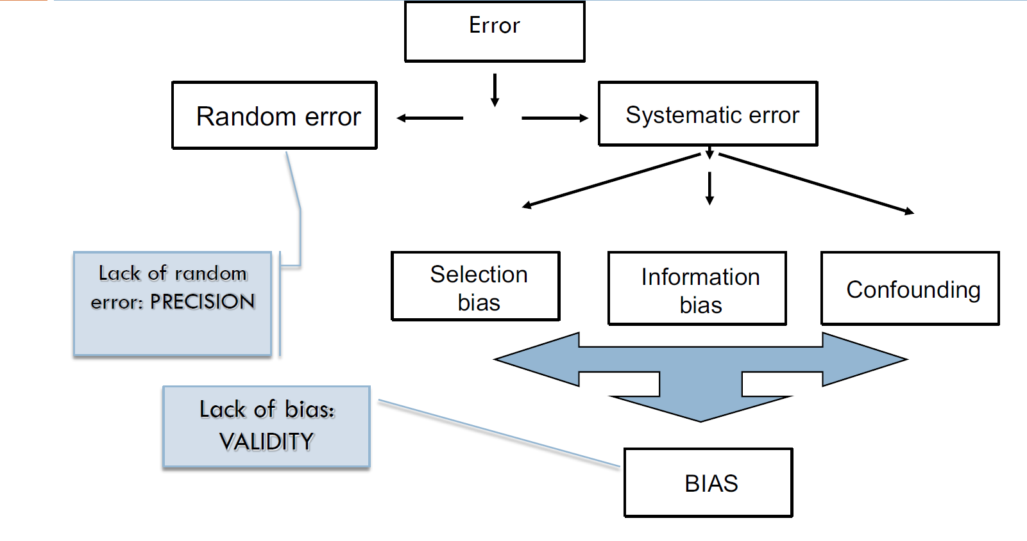
Types of error

Slide 3
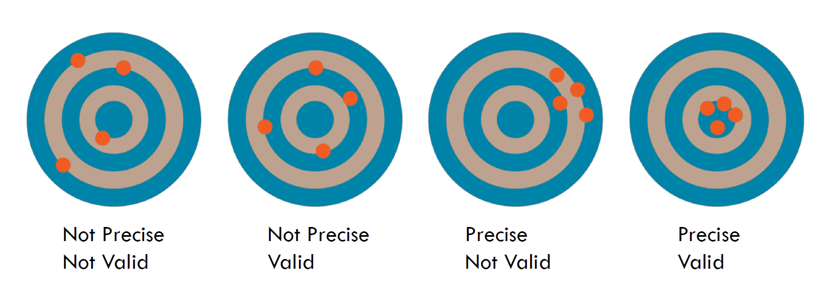
Types of error
Random error gets smaller as sample size (n) gets larger.
Systematic error does not get better with larger n.
Selection bias is a type of systematic error.

Slide 4
Selection bias definitions
Distinct from confounding and information bias because of its mechanisms.
Similar to confounding because exchangeability is violated.
Pr[A=a] is not independent of Yª
Traditional definition: “Selection bias is present when individuals have different probabilities of being included (or retained) in a study sample according to relevant characteristics, namely the exposure and outcome of interest.” (Szklo & Nieto, 2019)

Slide 5
Selection bias definitions
Structural definition: “Bias resulting from conditioning on a common effect (a collider) of two variables, one of which is the exposure or associated with the exposure and the other is either the outcome or associated with the outcome. (Adapted from Hernán, Hernández-Díaz, and Robins 2004).”
What?
Why do we need another definition?

Slide 6
DAG basics review and colliders
DAGs are diagrams that epidemiologist (and others) can use to visualize statistical relationships.
A → Y means A causes Y
Time flows left to right, top to bottom.
DAGs represent your assumptions and knowledge about causal relationships. They are not magic; they are just models.
DAGs are never cyclic because they are time specific.

Slide 7
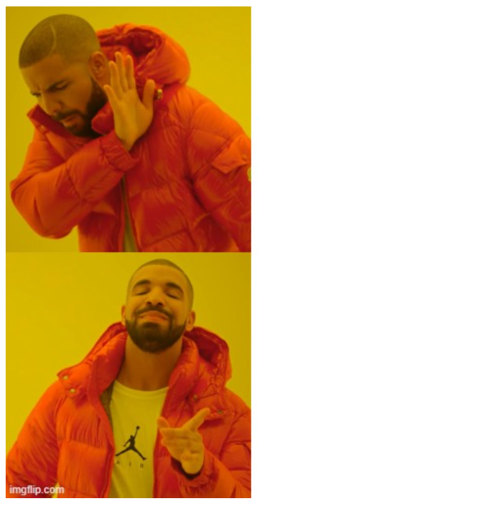
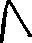

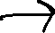
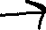
DAG basics review and colliders
DAGs are acyclic because they are time specific.

Slide 8

DAG basics review and colliders
DAGs help us understand the different ways we can see statistical associations in data.
Three basic ways (simplification)
A→Y (A causes Y)
A←C→Y (A and Y share a common cause aka confounding)
A→S←Y(A and Y share a common effect, S is a collider)
We must condition on the collider S (adjustment or restriction) or a descendent of a collider for us to detect a statistical association between A and Y in this scenario.

Slide 9
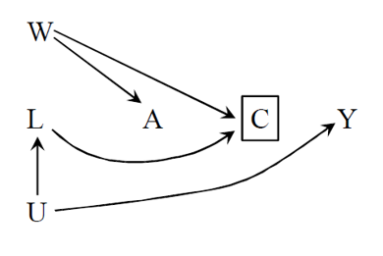
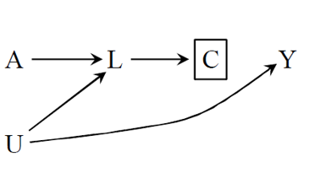
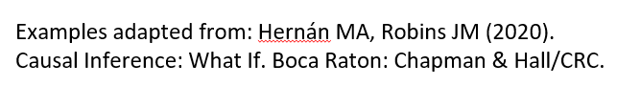
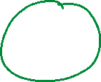
DAG basics review and colliders
Collider stratification is important to understand when thinking about selection bias.
Conditioning on a collider can induce statistical associations in more complex ways than A→S←Y

Slide 10
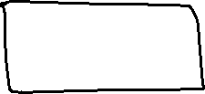
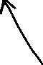
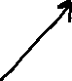
Collider heuristic
Did it rain last night?
We only observe when the sidewalk is wet.
The sidewalk is wet for two reasons. It rained or your neighbor ran the sprinkler.
If we know the sidewalk is wet and the neighbor’s sprinkler is broken, then it probably rained. Knowing about one cause gives us information about the other.

Slide 11
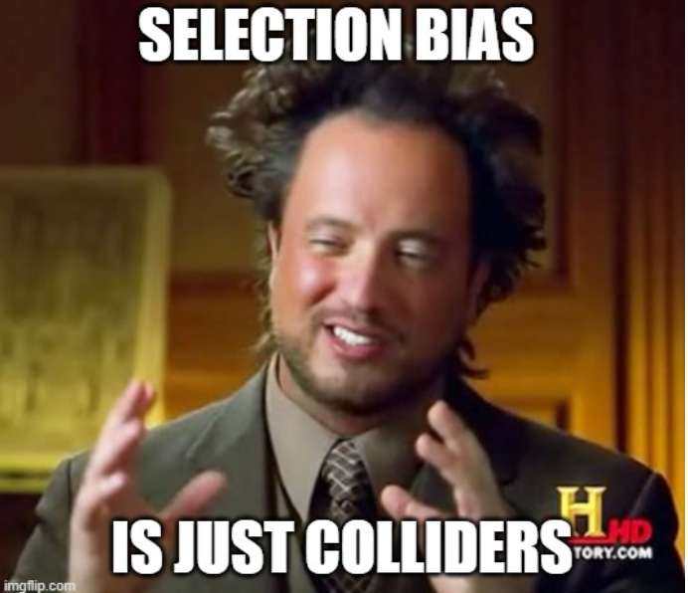
Why do we need a structural definition?
Helps us represent selection bias in DAGs.
Helps us have a unified framework for thinking about selection bias.

Slide 12
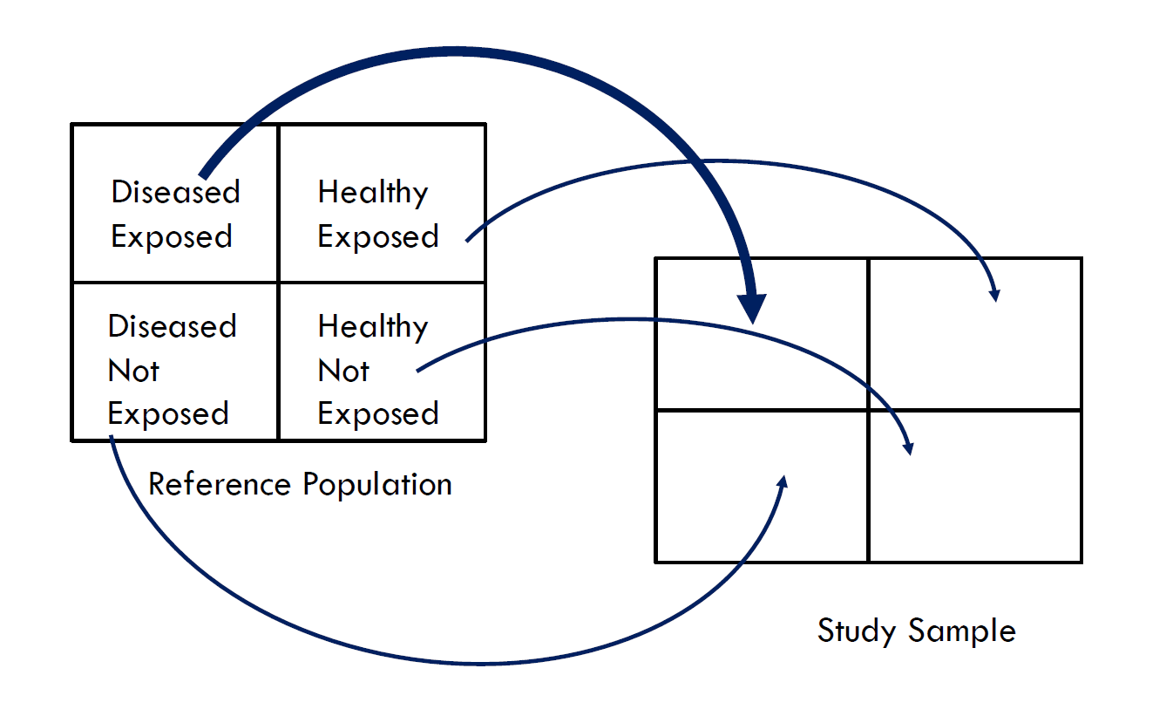
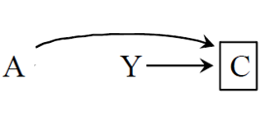
Traditional versus structural depiction
Traditional
Structural

Slide 13
Classic examples of selection bias
There are many ways that a study can be subject to selection bias.
Learning about well accepted types of selection bias can help with finding it in our own studies.
Somewhat different for case-control, cohort, ecologic, cross-sectional, and RCT studies.

Slide 14
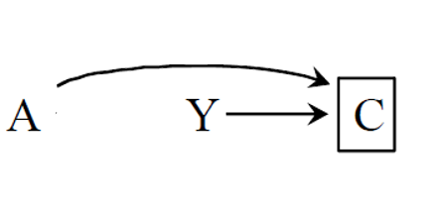
Selection bias in case-control studies
“Berkson’s bias”
Particularly relevant for hospital-based case-control studies.
Occurs when controls are not selected independent of exposure.
Case-control studies are thought to be particularly susceptible to selection bias because at the very least Y→S
A hospital-based case control study of the malnutrition (A) on depression (Y). Because of the study design those with depression (Y) are more likely to be included in the study (C). Malnutrition by itself is likely to cause somebody to be admitted to the hospital (C). This is also called “Berkson’s bias”

Slide 15
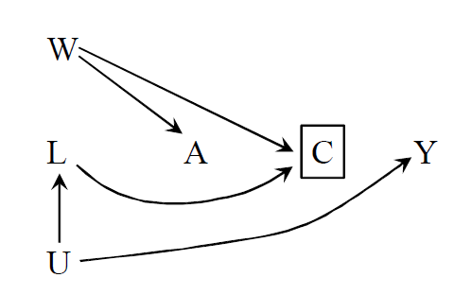
Selection bias in cohort studies
Selection bias in cohort studies typically arises because of loss to follow-up or mortality related to both the outcome and the exposure.
A study of occupational exposure (A) on risk of stroke (Y). The terrible work conditions of the job (W) is a common cause of exposure (A) and likelihood that a person will quit (C). Underlying health status (U) is a cause of stroke (Y) and causes a person to quit (C) through deteriorating physical health (L). This is also called the “healthy worker effect”.

Slide 16
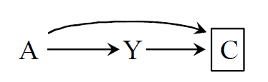
Selection bias in cross-sectional studies
Cross sectional studies are also susceptible to selection bias.
Sometimes this is referred to as “incidence-prevalence bias”.
Prevalent cases with better prognosis or underlying health are more likely to show up in your study.
A study of the effect of folic acid (A)
at conception on the prevalence of
birth defects (Y). Only those babies
Born were included in the study (C).

Slide 17
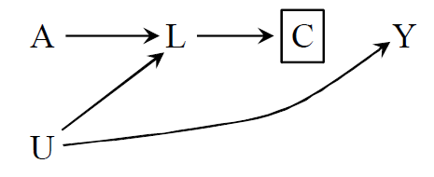
Selection bias in RCTs
RCTs are often thought to be the “gold standard” of causal inference.
While they are less likely to be subject to confounding, they are equally likely to be subject to selection bias because of LTF.
A study of the effect of AZT (A) on development of AIDS (Y). Treatment A and illness severity (U) both cause side effects (L) which leads to dropout (C).

Slide 18



Key points
Selection bias is a type of systematic error related to recruitment or retention of participants.
Recruitment or retention must be related to exposure and outcome to cause bias.
We can visualize selection bias on DAGs.
All types of studies (case-control, cohort, ecologic, RCT) are subject to selection bias but it might look different depending on the study.

Slide 19
Next session
Brief review
Predicting the direction of selection bias.
Methods for detecting selection bias in a study.
Methods for preventing or adjusting for selection bias.
IPW example (if there is time)

Slide 20
References
Hernán MA, Hernández-Díaz S, Robins JM. A Structural Approach to Selection Bias: Epidemiology. 2004;15(5):615-625. doi:10.1097/01.ede.0000135174.63482.43
Hernán MA, Robins JM (2020). Causal Inference: What If. Boca Raton: Chapman & Hall/CRC.

